Slide 1
Alpha College of Engg & Tech Khatraj, Gandhinagar EEE(2110005)
1st SEM EE-A Group 10
1 PATEL ULKABEN RAJENDRAKUMAR (130510109079 )
2 VINOD GIRI KHAMBHU GIRI (130510109108 )
3 RAJPUT MOHIT MANOJSINGH (130510109042 )
4 PATEL HARDIK PANKAJKUMAR (130510109060 )
5 PATEL ANUJKUMAR PRAHLADBHAI (130510109055 )
6 PARMAR MAYURKUMAR BHARATBHAI (130510109051 )
Faculty Name:
1 Prof. Narendra C. Mahavadia
2 Mr. Tushit M Desai

Slide 2
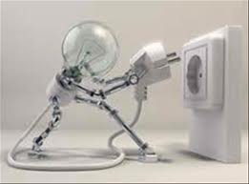
ILLUMINATION
BY GROUP 10

Slide 3
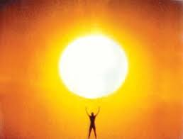
INTRODUCTION
All the day to day activities depend upon light
In the absence of natural light artificial light required . Artificial light is produced electrically

Slide 4
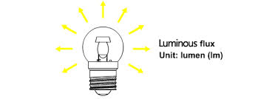
IMPORTANT TERMS
LIGHT:It is a form of electromagnetic energy radiated from a hot body which can be sensed by naked eye .
LUMINOUS FLUX:the total quantity of light emitted per second from a luminus body is called luminous flux

Slide 5
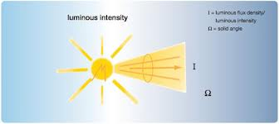
IMPORTANT TERM
LUMINOUS INTENSITY:The luminous intensity of source in a given direction is the intensity of the emission flux in that direction. The unit of the luminous intensity is CANDELA

Slide 6
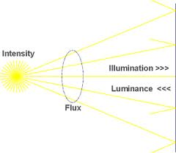
IMPORTANT TERM
ILLUMINATION:When the light(luminous flux) falls upno any surface the phenomenon is called illumination .it is measured in term of lumens/m sq or lux

Slide 7
LIGHTING SCHEMES
DIRECT LIGHTING
SEMI-DIRECT LIGHTING
SEMI-INDIRECT LIGHTING
INDIRECT LIGHTING
GENERAL LIGHTING

Slide 8
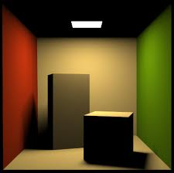
LIGHTING SCHEMES
DIRECT LIGHTING: Itis most commonly used scheme. About 80% to 90%of total light flux is made to fall directly upon the working plane with help of suitable reflectors.

Slide 9
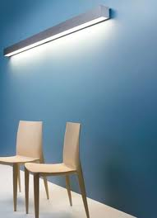
LIGHTING SCHEMES
SEMI-DIRECT LIGHTING:60% to 90% of total light flux is made to fall directly downward with the help of semi direct reflectors. The remaining light is used to illuminate ceilings and walls.

Slide 10
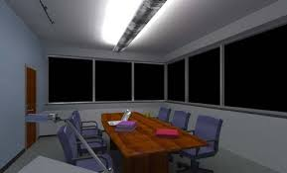
LIGHTING SCHEMES
SEMI-INDIRECT LIGHTING: 60% to 90% of total light flux is made to fall directly upwards to the ceiling by using inverted or bowl reflectors. Used in indoor decorations.

Slide 11
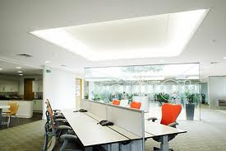
LIGHTING SCHEMES
INDIRECT LIGHTING: More than 90% of total light flux is thrown upward to the ceiling for diffused reflection by blow reflectors. The ceiling is now act as indirect light source and reflect the light on working place

Slide 12
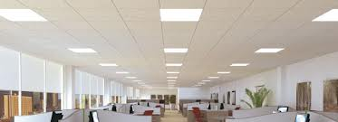
LIGHTING SCHEMES
GENERAL LIGHTING:This scheme is used to obtain diffused and glareless lighting which gives nearly equal illumination in all direction

Slide 13
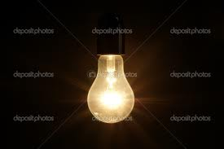
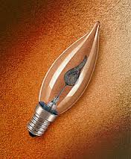
LAMPS
TYPES OF LAMP:
1)INCANDESCENT LAMPS
2)DISCHARGE LAMPS

Slide 14
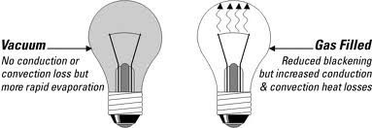
INCANDESCENT LAMPS
TYPES OF INCANDESCENT LAMPS:

Slide 15
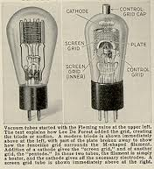
VACUUME LAMP
Current is passed through filament. Temperature of the wire is raised and light as well as heat energy is emitted
Higher temperature higher amount of light is emitted. Thus the filament should be such material whose temperature can be raised quickly without causing any damage e.g. Tungsten

Slide 16
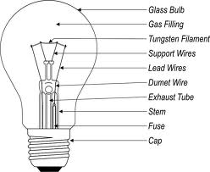
GAS FILLED LAMP
The melting point of tungsent is 3400 degree c. If the tungsten filament is operated at about 2100 degree c ,it vaporises rapidly and the life of lamp is very short
Hence the bulb is filled with an inert gas mostly nitrogen or argon.
The prevent arcing between two coil of spiral filament.

Slide 17
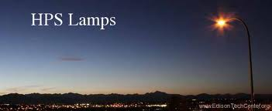
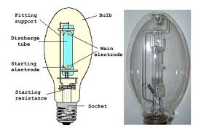
DISCHARGE LAMP
TYPE OF DIS CHARGE LAMP:
1)HPSV LAMP
2)HPMV LAMP

Slide 18
HIGH PRESSURE Mercury-vapor lamp(HPMV)

Slide 19
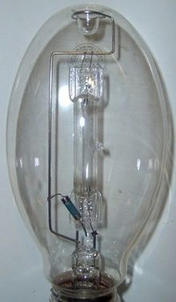
INTODUCTION OF HPMV LAMP
INTRODUCTION: Lamps of today are high pressure lamps with a fused quartz inner discharge tube. The high pressure helps increase efficiency and this was developed in 1936, 35 years after the low pressure lamps came out

Slide 20
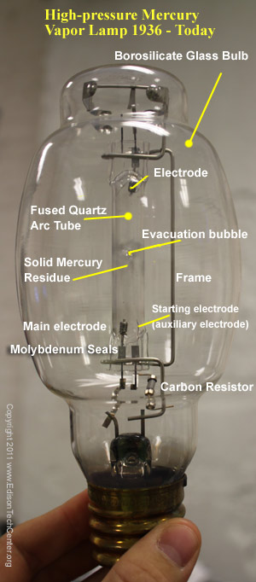

Slide 21
WORKING OF HPMV LAMP
This lamp start with a small arc between the starting electrode and the main electrode. This arc goes through argon gas which easily strikes, even in cold weather. This little arc heats the tube, and over several minutes the tube gets hot enough to vaporize the solid mercury stuck to the sides. The mercury vaporized creates a strong light between the two main electrodes.

Slide 22
HIGH PRESSURE Sodium vapor lamp(HPSV)

Slide 23
INTODUCTION OF HPSV LAMP
INTODUCTION: Sodium vapour lamps have replaced mercury lamps. Efficiency is about 40 to 50 lumens per watt avg life of 3000 hours. The glass tube is made specially chemical resistant to withstand the the chemical reaction of hot sodium. The must be operated at horizontal position to keep sodium uniform throughout.

Slide 24
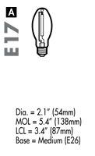
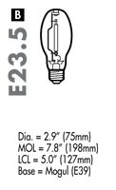
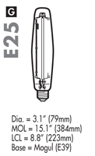
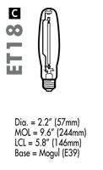
TYPES OF HPSV LAMPS

Slide 25
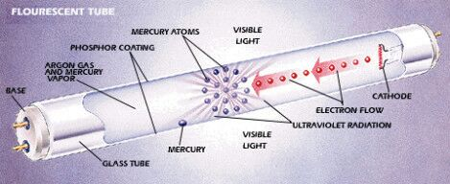
FLUORESCENT TUBES/LAMPS
FLUORESCENT TUBES:-

Slide 26
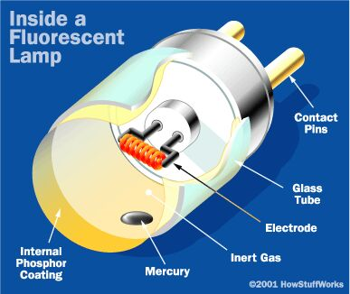
FLUORESCENT TUBES/LAMPS
FLUORESCENT LAMPS:-
FLUORESCENT TUBES/LAMPS

Slide 27
INTODUCTION OF FLUORESCENT TUBES/LAMPS
INTODUCTION: The tubes are filled with argon gas at low pressure and one and two drop of mercury. The inner surface of the tube has thin coating of fluorescent material. Different types of colour can be obtained by this coating. The mercury vapour emits UV radiation when electric charge through it. The fluorescent coating convert UV radiation into visible light.

Slide 28
THANK YOU

